Slide 1
Introduction to AWS Step Functions
Orchestrate Serverless Workflows

Slide 2
AWS Step Functions & State Machines
What is AWS Step Functions A fully managed, serverless orchestration service that helps you coordinate multiple AWS services into reliable, scalable workflows using visual flowcharts and JSON-based definitions.
What is a State Machine
The core definition of your workflow in Step Functions:
Describes each step (state) and transition using Amazon States Language (JSON)
Includes built-in state types: Task, Choice, Pass, Wait, Fail, Succeed, Parallel, Map
Controls flow based on data & conditions

Slide 3
Key Features of AWS Step Functions
Coordinates services like Lambda, ECS, SQS, DynamoDB, SNS etc
Built-in error handling and retries
Visual editor with execution history
Conditional logic with Choice states

Slide 4
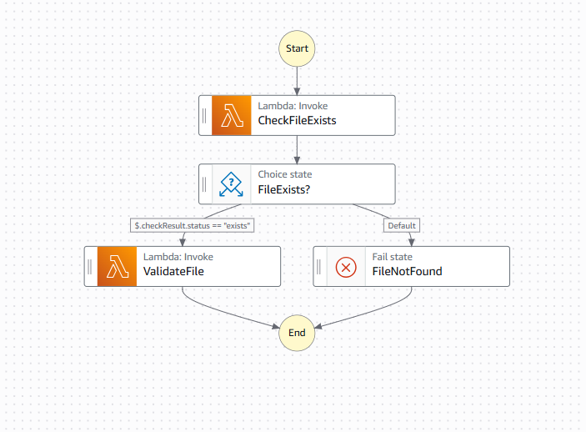
Demo Use Case
File Validation Workflow Using AWS Step Functions and Lambda
Workflow Diagram:
I

Slide 5
Thank You!

